Slide 1
IPv6 Routing
Milo Liu
SW2
R&D
ZyXEL Communications, Inc

Slide 2
Outline
Routing background
IPv6 routing table
Static routing
Dynamic routing and IPv6 routing protocols
End-to-end IPv6 packet delivery process
Static IPv6 routing support in Windows
Q & A

Slide 3
Routing Background
If in whole internet use one Ethernet to connect each one.
If each one connect others using direct connection.
The world is big, and we need much more.

Slide 4
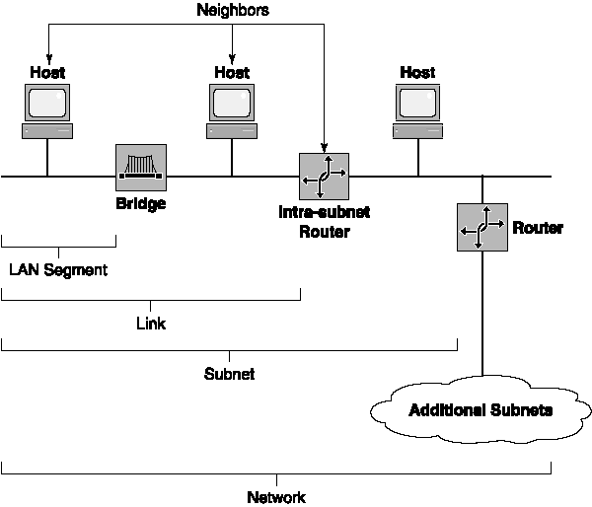
Routing Background

Slide 5
Routing Background
Subnet network
Network Layer
Subnet base on IP
Data-link Layer
Subnet base on MAC or Port, Such VLAN
Physical Layer

Slide 6


IPv6 Addressing Review
Host B
Router 2
internet
Subnet 2
Router 1
Subnet 1
Global: 3000:4D:C00:: 20D:60FF:FECB:6255
Site: FEC0::1: 20D:60FF:FECB:6255
Link: FE80::20D:60FF:FECB:6255
Multicast: FF01::1
FF02::1
FF02::1:FFCB:6255
Host A

Slide 7
IPv6 routing table
A routing table is present on all nodes
  Stores information about IPv6 network prefixes and how they can be reached
IPv6 checks destination cache first
If destination is not in the destination cache, the routing table is used to determine:
  1. The interface to be used for the forwarding (the next-hop interface)
  2. The next-hop address

Slide 8
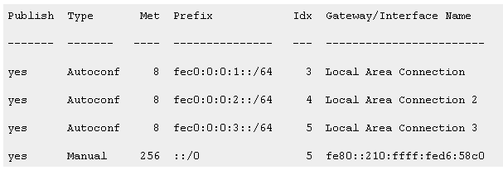
IPv6 routing table

Slide 9
IPv6 Routing Table Entry Types
Directly attached network routes
  64-bit prefix length
Remote network routes
  64-bit or lower prefix length
Host routes
  128-bit prefix length
Default route
  Prefix of ::/0
Notes:
Global unicast address to satisfy ISPs tier requirement

Slide 10
Sample Windows IPv6 Routing Table
Publish Type Met Prefix Idx Gateway/Interface Name
------- -------- ---- ------------------------ --- ---------------------
yes Manual 1001 2002::/16 3 6to4 Tunneling Pseudo-Interface
no Autoconf 8 fec0:0:0:f282::/64 4 Intranet
no Autoconf 8 3ffe:2900:d005:f282::/64 4 Intranet
no Autoconf 256 ::/0 4 fe80::210:ffff:fed6:58c0
2002::/16
  6to4 route
fec0:0:0:f282::/64
  Site-local subnet prefix, directly attached
3ffe:2900:d005:f282::/64
  Global subnet prefix, directly attached
::/0
  Default route
Notes:
Even in the absence of a router, hosts on the same link can automatically configure themselves with link- local addresses and communicate without manual configuration. Link-local addresses are auto-configured within one second and communication with neighboring nodes on the link is possible immediately. In comparison, an IPv4 host using DHCP must wait a full minute before abandoning DHCP configuration and self-configuring an IPv4 address. (169.254.0.0/16)

Slide 11
Static Routing
Static routing
  Routing table entries are manually configured and do not change with changing network topology

Slide 12
Dynamic routing
Dynamic routing
  Routing table entries are automatic configured and change with changing network topology
  Routers use a routing protocol for ongoing communication

Slide 13
IPv6 routing protocols Technologies
Distance vector
  Routing information is network IDs and their “distances” (hop counts)
Link state
  Routing information is link state advertisements (LSAs), consisting of a router’s attached network prefixes and their assigned costs
Path vector
  Routing information is sequences of autonomous system numbers indicating the path for a route

Slide 14
IPv6 Routing Protocols
RIPng for IPv6
  Distance vector
OSPF for IPv6
  Link state
Integrated Intermediate System-to-Intermediate System (IS-IS) for IPv6
  Link state
BGP-4
  Path vector
Inter-Domain Routing Protocol version 2 (IDRPv2)
  Path vector

Slide 15
End-to-end IPv6 packet delivery process
1. Sending host process
2. Router forwarding process
3. Receiving host process

Slide 16
Sending Host Process
Set value of Hop Limit field.
Check destination cache for an entry
matching the destination address.
Check neighbor cache for an entry
matching the next-hop address.
Matching
entry found
in destination
cache?
Yes
Obtain next-hop address from
destination cache entry.
Is next-hop
address entry in
neighbor cache?
Yes
Send packet using link-layer address
of neighbor cache entry.
No
Check routing table for longest
matching route to the destination.
Update destination cache.
No
Use address resolution process to
determine the link-layer address
of the next-hop address.
Is there a longest
matching route?
No
Set the next-hop address to
the destination address.
Was
address resolution
successful?
Yes
Update neighbor cache.
Yes
Set the next-hop address to
the next-hop address of the route.
No
Indicate an error.

Slide 17
Router Forwarding Process-Part 1
Check destination cache for an entry
matching the destination address.
A
Check the destination address.
Is destination
address assigned
to the router?
Matching
entry found
in destination
cache?
Yes
Yes
Obtain next-hop address from
destination cache entry.
Process packet as the destination.
No
No
Decrement Hop Limit value by 1.
Check routing table for longest
matching route to the destination.
Is Hop Limit > 0?
Is there a longest
matching route?
Yes
No
Send ICMPv6 Destination Unreachable-No Route to Destination message and discard packet.
Update Hop Limit field in IPv6 header.
No
Yes
Send ICMPv6 Time Exceeded-Hop Limit Exceeded in Transit message and discard packet.
Set the next-hop address to
the next-hop address of the route.
Update destination cache.

Slide 18
Router Forwarding Process-Part 2
A
Is the
link MTU of the
next-hop interface less
than the size of
the packet?
Is next-hop
address entry in
neighbor cache?
Send ICMPv6 Packet Too Big message and discard packet.
Yes
No
Yes
Send packet using link-layer address
of neighbor cache entry.
No
Use address resolution to
determine the link-layer address
of the next-hop address.
Was
address resolution
successful?
Yes
Update neighbor cache.
No
Send ICMPv6 Destination Unreachable-Address Unreachable message and discard packet.

Slide 19
Receiving Host Process
Receive the packet.
Is destination
address assigned to
a local interface?
Does the
protocol
for the Next Header
field value
exist?
Yes
No
Send ICMPv6 Parameter Problem-Unrecognized Next Header Type Encountered message and discard the packet.
Process extension headers (if present).
No
Yes
Silently discard the packet.
Is the upper
layer PDU a UDP
message?
Is there an
application listening
on the destination
UDP port?
Yes
No
Send ICMPv6 Destination Unreachable-Port Unreachable message and discard the packet.
No
Yes
Is the upper
layer PDU a TCP
segment?
Is there an
application listening
on the destination
TCP port?
Yes
Yes
Process contents.
No
No
Pass upper layer PDU to upper layer protocol.
Send TCP Connection Reset segment.

Slide 20
Static IPv6 Routing Support in Windows
Host B
Subnet 2
FEC0:0:0:2::/64
Router 1
Router 2
Subnet 1
Subnet 3
FEC0:0:0:1::/64
FEC0:0:0:3::/64
Host A
Host C

Slide 21
Static IPv6 Routing Support in Windows
Router 1 sends Router Advertisement messages on Subnet 1 that contain a Prefix Information option to autoconfigure addresses for Subnet 1 (FEC0:0:0:1::/64), an MTU option for the link MTU of Subnet 1, and a Route Information option for the subnet prefix of Subnet 2 (FEC0:0:0:2::/64). By default, the MTU of the link is advertised.
Router 1 sends Router Advertisement messages on Subnet 2 that contain a Prefix Information option to autoconfigure addresses for Subnet 2 (FEC0:0:0:2::/64), an MTU option for the link MTU of Subnet 2, and a Route Information option for the subnet prefix of Subnet 1 (FEC0:0:0:1::/64).

Slide 22
Static IPv6 Routing Support in Windows
Router 2 sends Router Advertisement messages on Subnet 2 that contain a Prefix Information option to autoconfigure addresses for Subnet 2 (FEC0:0:0:2::/64), an MTU option for the link MTU of Subnet 2, and a Route Information option for the subnet prefix of Subnet 3 (FEC0:0:0:3::/64).
Router 2 sends Router Advertisement messages on Subnet 3 that contain a Prefix Information option to autoconfigure addresses for Subnet 3 (FEC0:0:0:3::/64), an MTU option for the link MTU of Subnet 3, and a Route Information option for the subnet prefix of Subnet 2 (FEC0:0:0:2::/64).

Slide 23
Static IPv6 Routing Support in Windows
Host B
Subnet 2
FEC0:0:0:2::/64
Router 1
Router 2
Subnet 1
Subnet 3
FEC0:0:0:1::/64
FEC0:0:0:3::/64
Host A
Host C

Slide 24
Static IPv6 Routing Support in Windows
Configure Router 1 to publish a route to Subnet 3 with the next-hop address of Router 2's link-local address on Subnet 2 and configure Router 2 to publish a route to Subnet 1 with the next-hop address of Router 1's link-local address on Subnet 2.
Configure Router 1 to publish a default route with the next-hop address of Router 2's link-local address on Subnet 2 and configure Router 2 to publish a default route with the next-hop address of Router 1's link-local address on Subnet 2.

Slide 25
Training course arrangement
Date
Subject
Lecturer
03/10
Introduction to IPv6
Joe Zhao
03/16
IPv6 Addressing
Milo Liu
03/23
IPv6 Header & Extensions
Joe Zhao
03/23
ICMPv6
Feng Zhou
03/30
Neighbor Discovery Protocol
Billy Bian
03/30
Multicast Listener Discovery
Jeffrey Zhou
04/06
Address Autoconfigurator
Feng Zhou
04/06
IPv6 Routing
Milo Liu

Slide 26
Training course arrangement
Date
Subject
Lecturer
04/13
IPv6 Migration Mechanisms
Joe Zhou
04/20
IPv6 Mobility
Milo Liu
Setting Up an IPv6 Test Lab

Slide 27
Q & A

